Slide 1


Student Hiring Process

Slide 2
Human Resources Hiring Overview

Slide 3
NextGen
Paycom
Supervisor/Manager posts jobs
Students apply to jobs
Approval to work comes from Nextgen
Students submit timesheets
Managers approve timesheets
Onboarding completed in Paycom
Paycom stores the following data:
  Address
  Direct Deposit
  Taxes
  Pay stubs
  W2’s

Slide 4
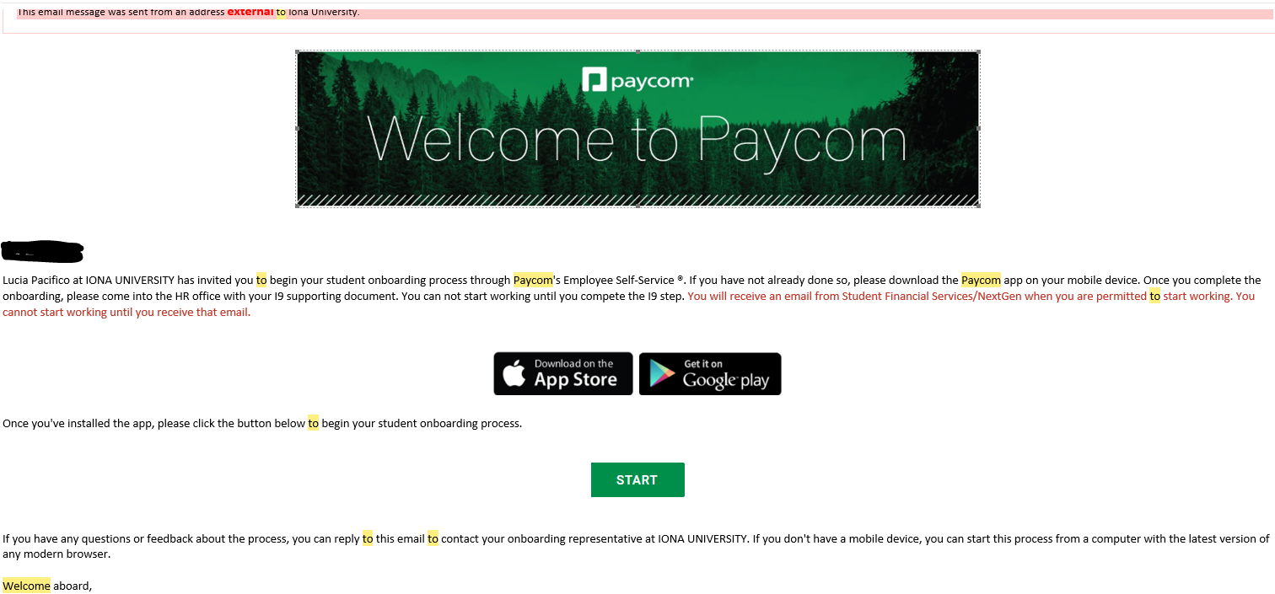
Student Onboarding
A Paycom generated email (Systemmessage@Paycomonline.com) will be sent to the student to initiate the onboarding.

Slide 5
Student Onboarding
What does onboarding include?
Taxes
Direct Deposit
Personal Information
When all sections are complete Paycom will give a notification saying,
“ Congratulations, you have completed your onboarding!”

Slide 6
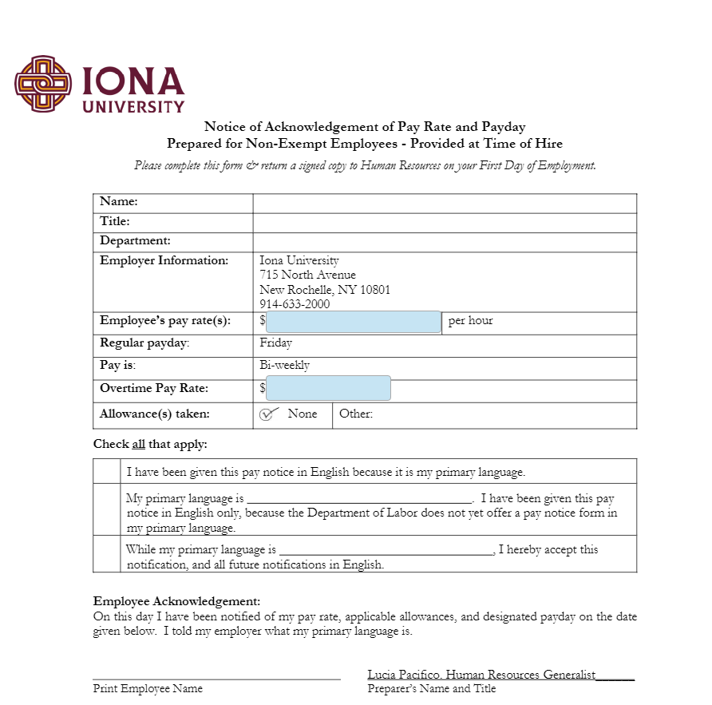
Student Onboarding
HR will hire the student into Paycom once onboarding
is completed.
The student will receive 2 emails from Paycom
(Systemmessage@Paycomonline.com):
  Email #1 will share Paycom credentials.
  Email #2 will request they complete the
  “ Acknowledgement of Pay Rate and Payday”

Slide 7
Hiring Process
Students are required to bring I-9 documentation to HR upon completion of their Paycom onboarding.
Once all required Paycom/I-9 documentation is complete, SFS will be notified by Human Resources to hire the student into NextGen.
Once officially hired into NextGen the student/supervisor will receive an email that they are able to begin work. Students CANNOT work until this notification is received.
Student timesheets are completed in NextGen not in Paycom.

Slide 8
Student Financial Services
Hiring Overview

Slide 9
Sequence for successful student hiring
Supervisor posts job in NextGen
Students apply for job online in NextGen
Supervisor interviews student
Supervisor hires student in NextGen
Student will be sent an onboarding email by Human Resources
Once student completes all required onboarding documentation, Human Resources will notify Student Financial Services to process the hire in NextGen
Once Student Financial Services completes the hire in NextGen, both the student and supervisor will receive a confirmation email and only at that point is the student authorized to begin working

Slide 10
Supervisor Do’s
Ensure your department has a budget line to pay students (if not Federal Work Study job.) Please contact the Director of Financial Analysis and Budgets, Ms. Fatima Ferreira at fferreira@iona.edu for confirmation and questions regarding department budgets.
When submitting a job for approval, you must select Listed for it to move from Review Mode to come over for approval.
All jobs posting require a secondary supervisor and they must work in your department.
Jobs are for the fiscal year 7/1/20**-6/30/20**. For example, 7/1/2023-6/30/2024 – jobs that breach the fiscal year will need to be re-posted 7/1/20**.
Enter time worked on current timesheet only.
Approve your student timesheets by the deadline Mondays bi-weekly by noon (student deadline is Saturdays bi-weekly by noon).
Monitor your students’ earnings – for Federal Work Study (FWS) increase requests please email jconnolly@iona.edu for review.
Monitor your students’ earnings – for Campus Employment (CMP) review your student expenditures in Adaptive.
If your student needs to be transferred from FWS to CMP complete the Status Change/Rate of Pay Change Request Form available at https://iona.studentemployment.ngwebsolutions.com/Cmx_Content.aspx?cpId=7 and submit to jconnolly@iona.edu.

Slide 11
Supervisor Don’ts
Never post a job (that is not FWS) without confirming your department has a budget to pay student employees.
Never allow students to work prior to receiving the official hire confirmation email from jconnolly@iona.edu.
Undergraduate students are not permitted to work above 20 hours per week across all jobs on campus.
Graduating students must cease working by the last day of final exams.
If a student works prior to being officially hired by the university, the student will be paid from that department’s budget, regardless of work study eligibility.

Slide 12
Status Change/Rate of Pay Change Request Form
For Student Employees
Managers/Supervisors will need to download this form from NextGen and complete when changing a student from FWS to CMP (federal work study to campus employment.)
This must be completed and sent to jconnolly@iona.edu prior to a student exhausting their federal work study funds.
Please be sure to confirm your department has a budget to pay student employees; all requests to pay students from department budgets will be processed and if funding is not available the supervisor will be responsible for this transfer.

Slide 13
How to Request a Login for NextGen

Slide 14
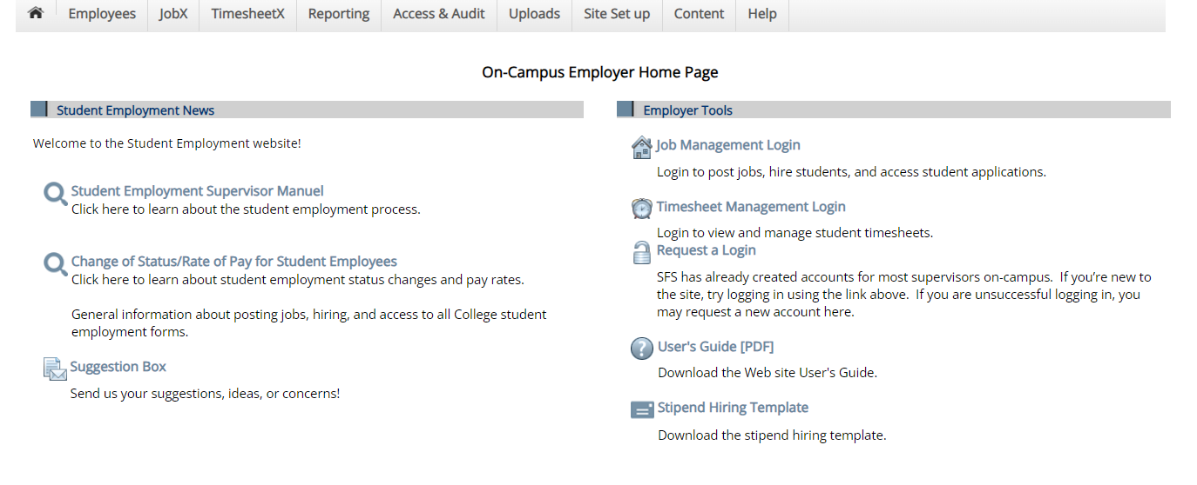
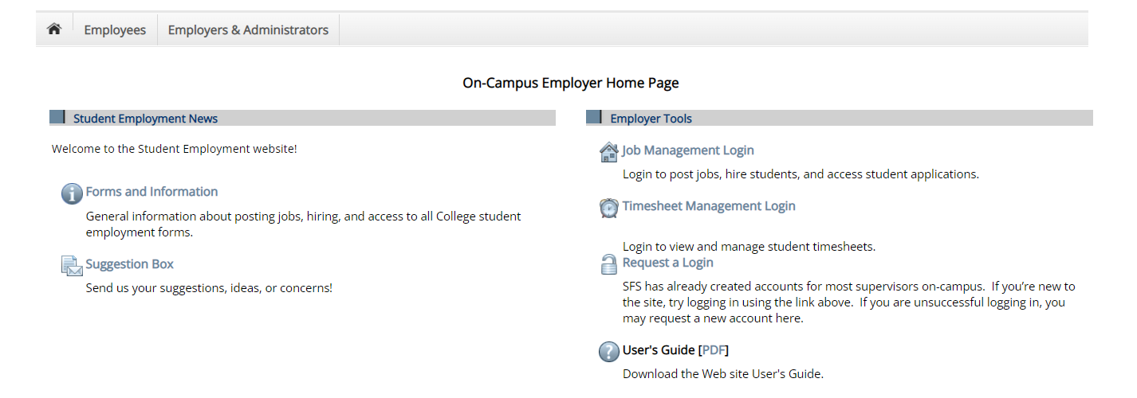
Go to http://iona.studentemployment.ngwebsolutions.com
Click on Request a Login.

Slide 15
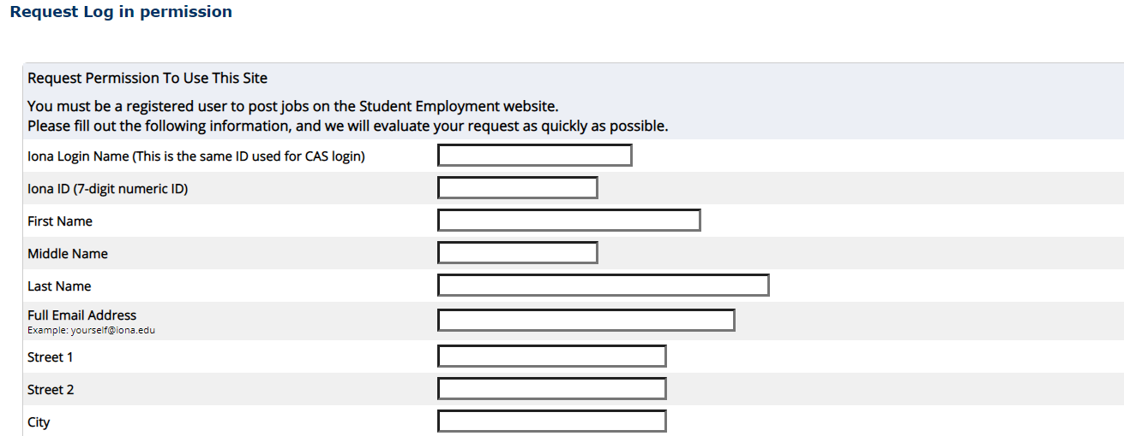
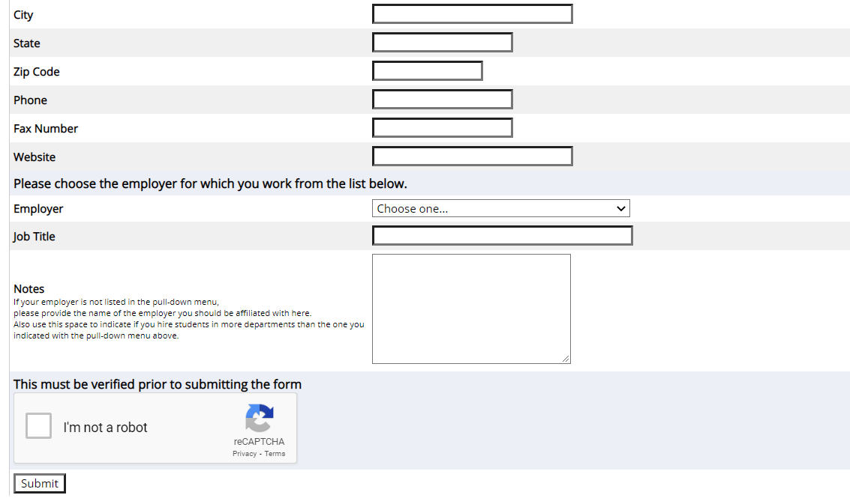
Complete the fields using your single sign on credentials and Iona email address.
You will need your department cost center to request access.
Once approved the Supervisor will receive an email stating access was approved.

Slide 16
How to Post a Job

Slide 17
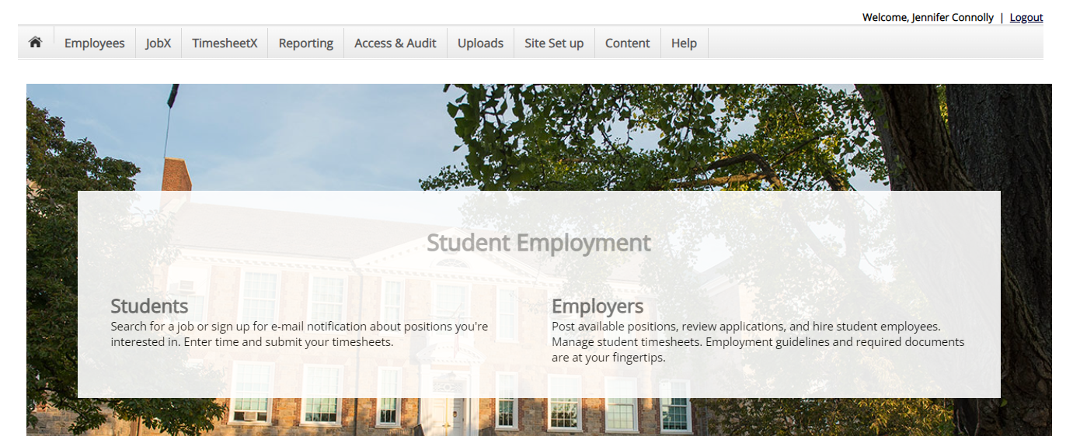
Go to https://iona.studentemployment.ngwebsolutions.com

Slide 18
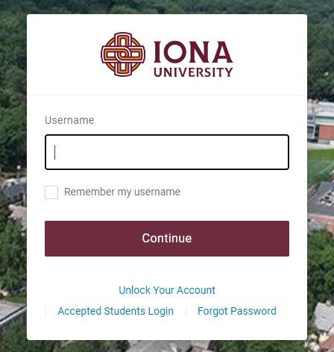
Log in using your Iona Single Sign-On Credentials

Slide 19
Click Job Management Login

Slide 20
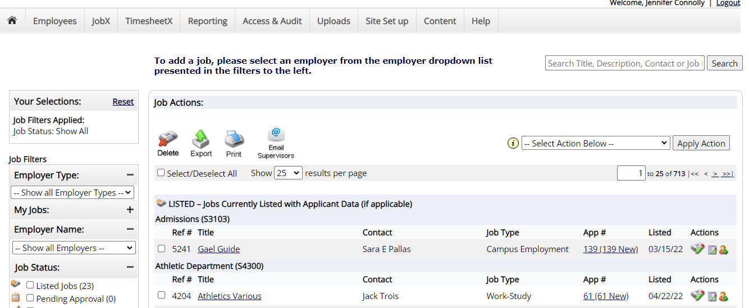
Click Employer Name

Slide 21
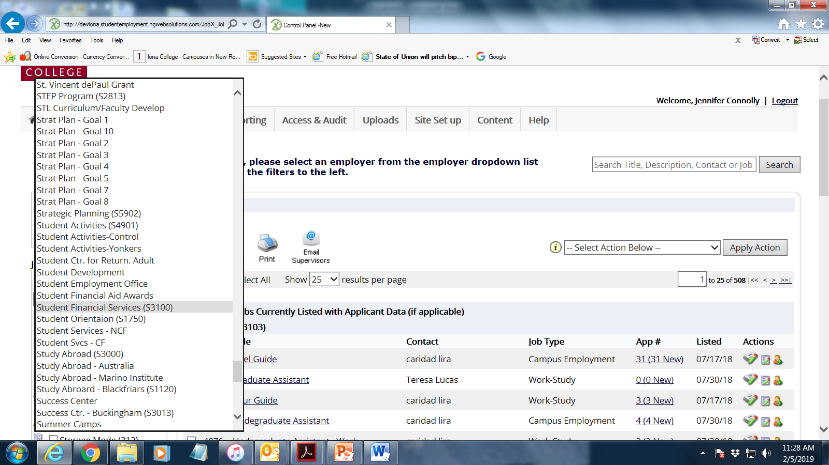
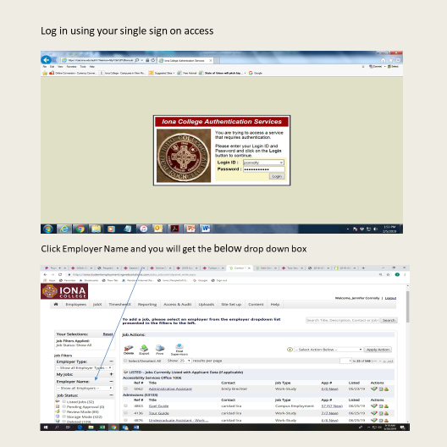
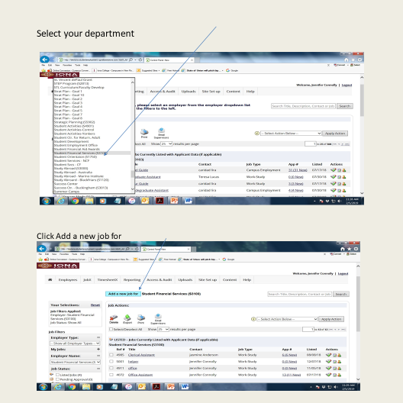
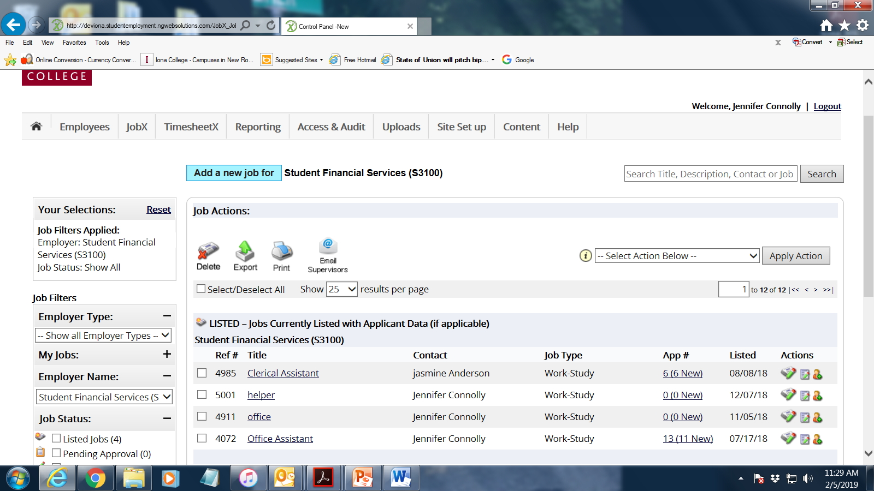

Select Your Department
Go to Click Add a new job for your department

Slide 22

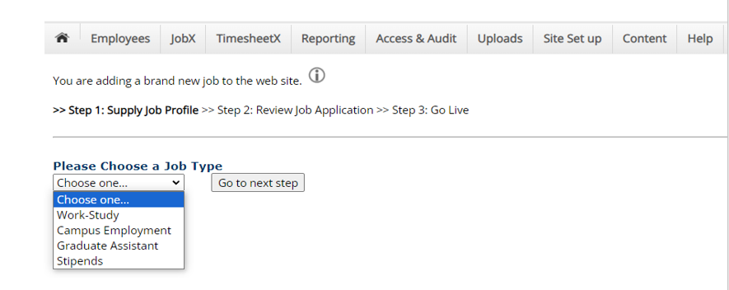
Choose Your Job Type
-students you will hire that will use the Federal Work Study program, select Work-study
-students you will hire that will be paid from your Department Budget, select Campus Employment
-students who are Graduate level and will be hired as a Graduate Assistant to be paid from your Department Budget, select Graduate Assistant
-students you will hire that will be paid from a Stipend from your Department Budget, select Stipend**NEW OPTION**
**Stipend roles are for positions that do not work a set schedule. Stipend positions must be approved by the Senior Leader and Human Resources prior to being submitted to Nextgen. Stipend positions cannot be paid through Federal Work Study.**
-Supervisors can post a graduate level position, that can be paid from Work Study funds, for this you would select Work-Study and indicate in the job title/description that it is for work study eligible Graduate students
-In order to hire students that you wish to pay from your department budget as well as having a work study student population, you must post two jobs, one under work-study and one under campus employment

Slide 23
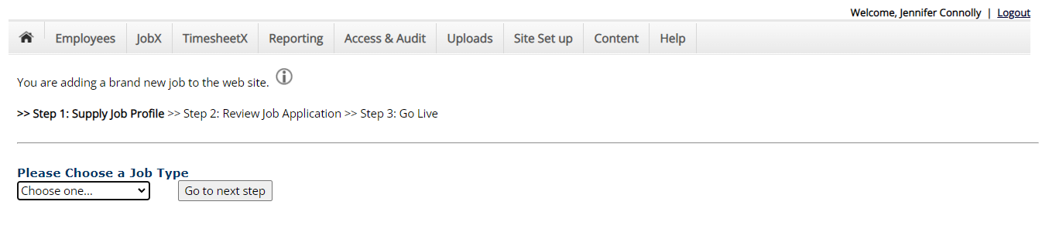
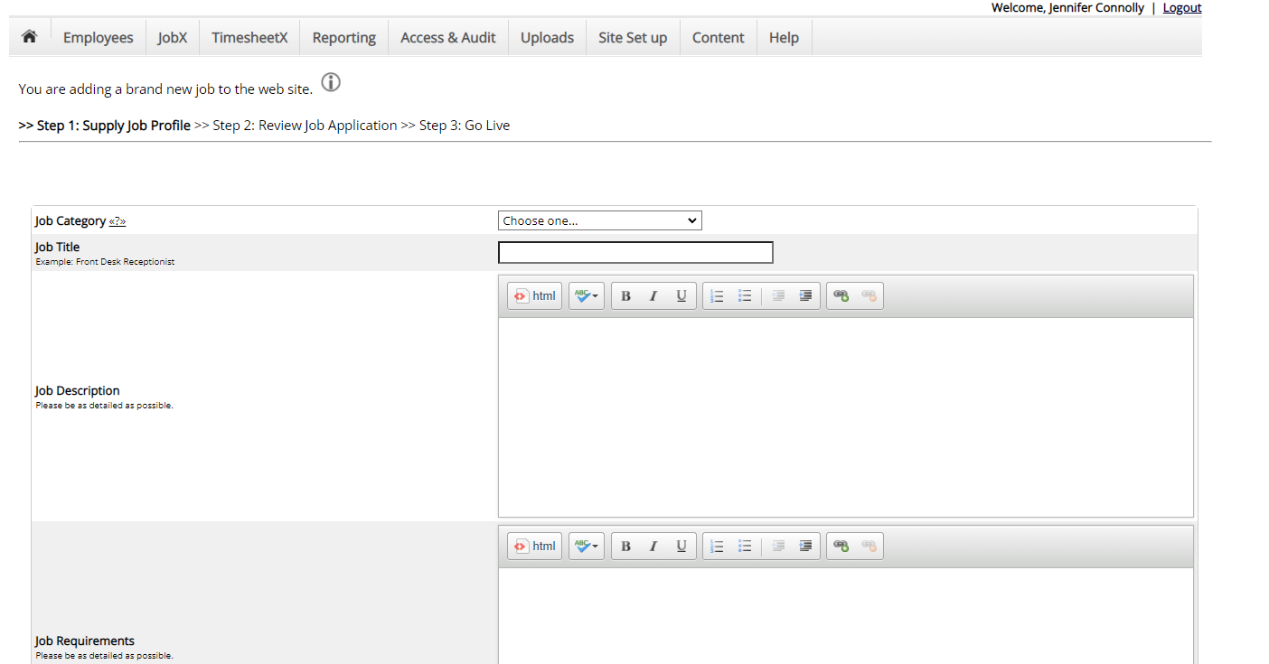
Once you have made your selection, click “Go to Next Step”
Here you will fill in Job Category from the drop down Job Title, Job Description, Requirements

Slide 24
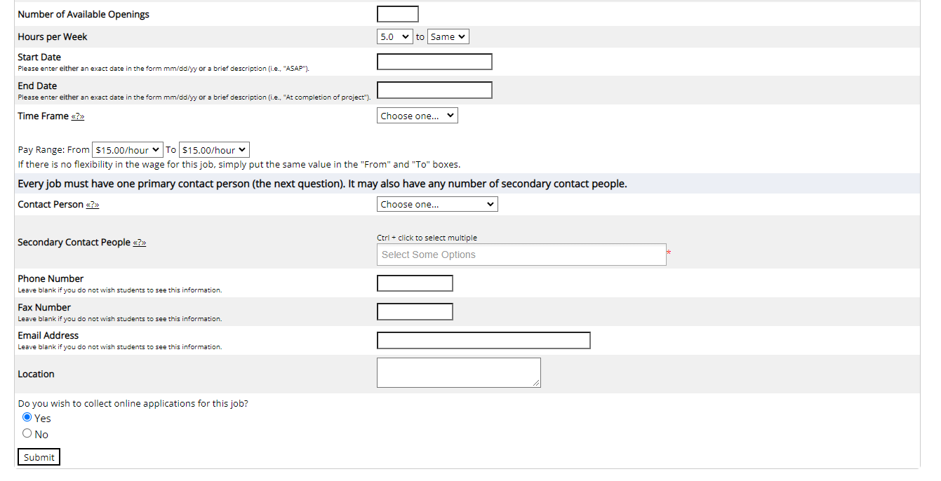
Enter # of Available Openings. Start Date and End Dates are for a Fiscal Year. Jobs can start anytime after 07/01/20** but must have an end date no later than 06/30/20** of that fiscal year. Do not cross over Fiscal years.
Please know that a Secondary Supervisor is required for each job posting; the Secondary must be a staff member who can monitor and attest to student work performance and attendance.

Slide 25
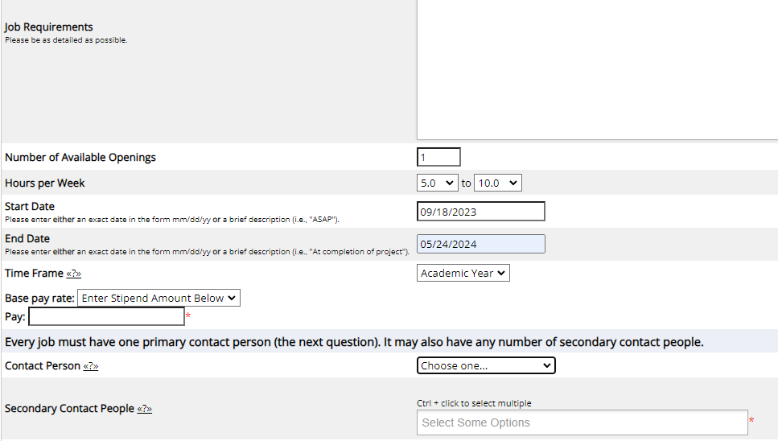
If you select Stipend, you will enter the total amount of the stipend, and the job start and end dates. This will generate equal bi-weekly payments across the duration of the job.
⋅To hire students into a Stipend job, a spreadsheet would be completed and submitted to SFS to process the hires via a file load process (this is unlike the FWS and Campus Employment jobs where supervisors hire the students in NextGen.)

Slide 26
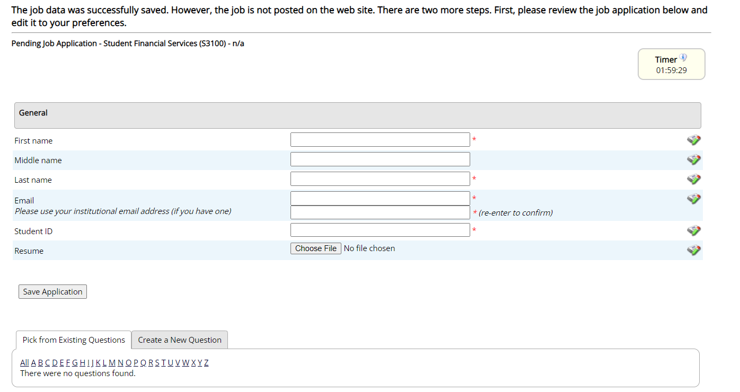
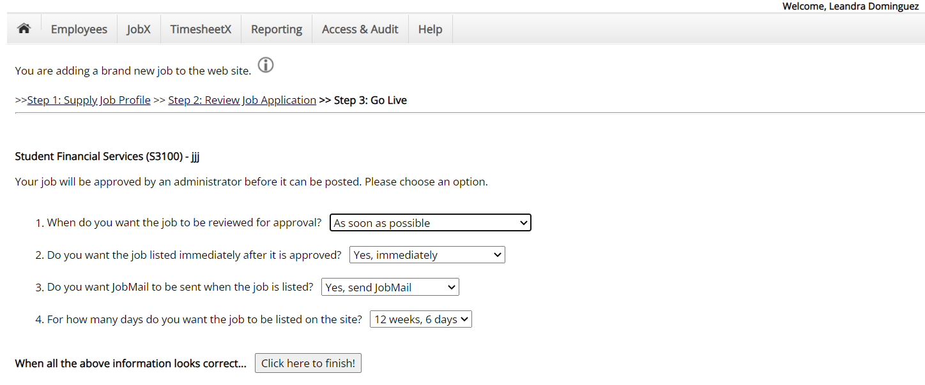
This next page does not need to be completed to proceed, just Save Application.
Here you will indicate when and for how long the job will be posted, as well as sending JobMail emails to students. Click Finish.

Slide 27
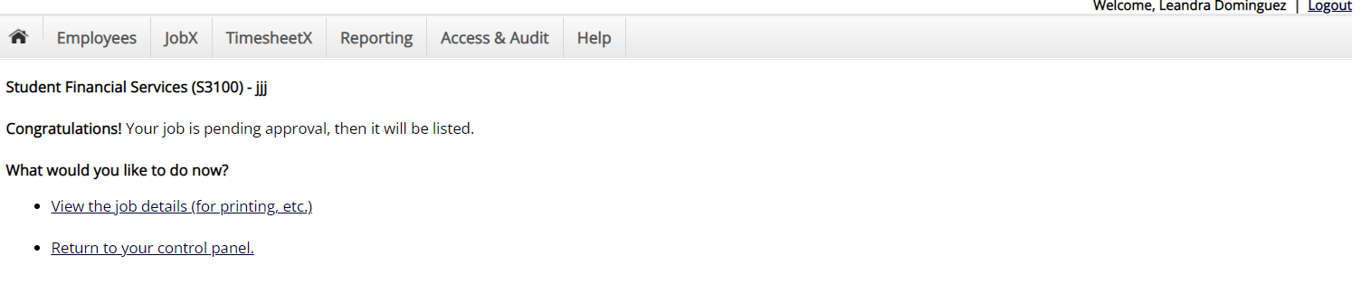
At this point your job has been submitted for review. Once reviewed, you will receive an email confirming it’s posting to the site or a rejection if corrections need to be made.

Slide 28
How to Determine if a Student Has a Federal Work Study Award

Slide 29
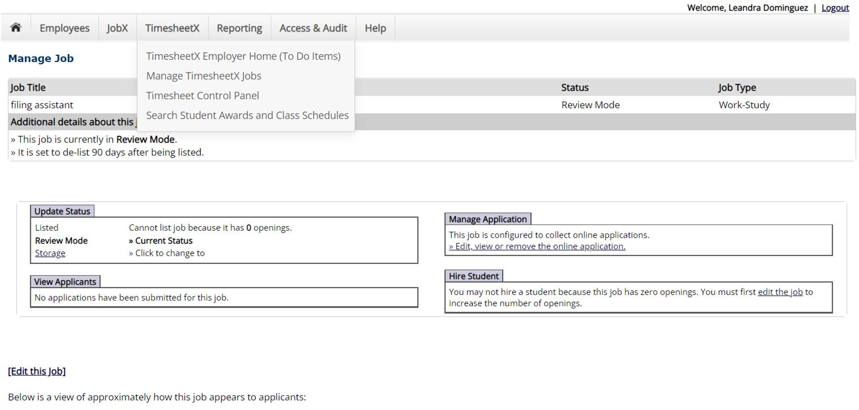
Click on TimesheetX, follow to Search Student Awards and Class Schedules.

Slide 30
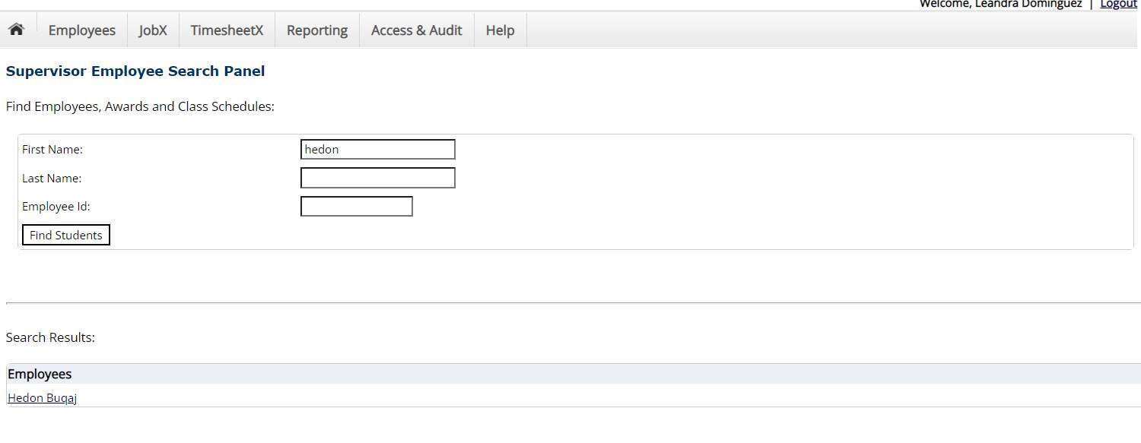
Search by student name or student ID#. Click Find Students. Once student name appears, click on student’s name.

Slide 31
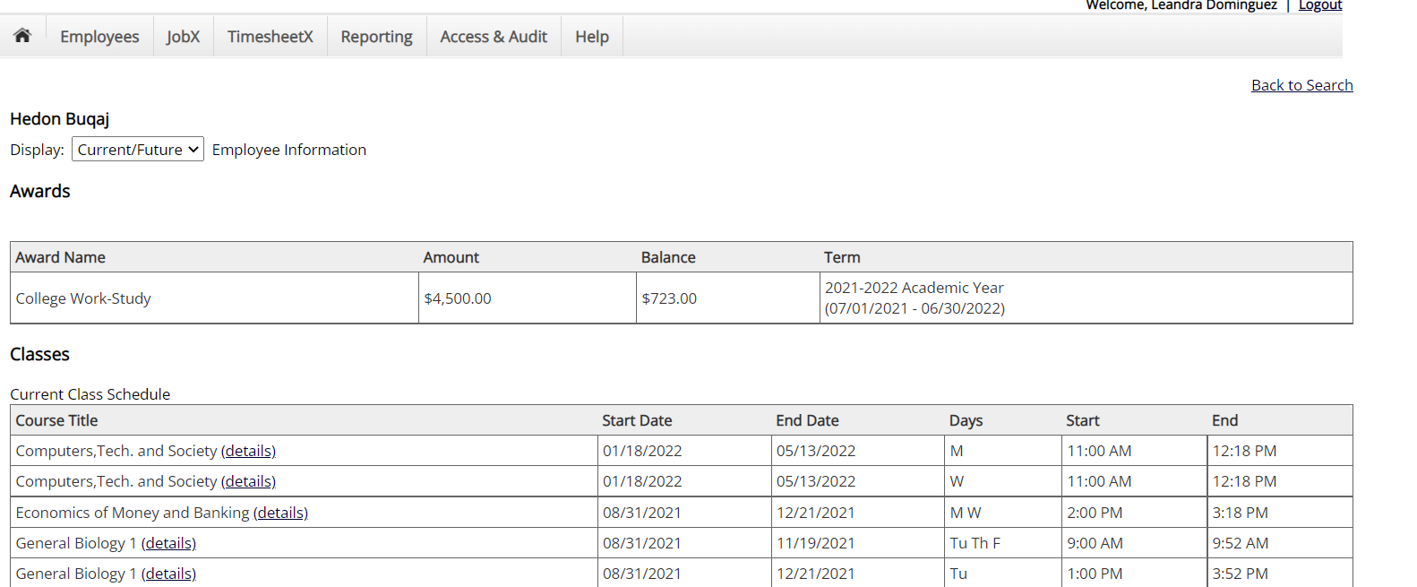
Here you can see if any student has a Federal Work Study award for the aid year, the Amount, and the remaining Balance. You will also see their class schedule for the term/year.

Slide 32
How to Hire an Applicant in NextGen for a Stipend Job

Slide 33
Hiring Process for Applicants in a Stipend Job
-Once your Stipend position has been approved by the Senior Leader and Human Resources and you’ve submitted the position in Nextgen, follow the below steps to hire your student employees:
-Supervisors will complete the template below for all student hires of the Stipend Job (available at https://iona.studentemployment.ngwebsolutions.com/Cmx_Content.aspx?cpId=7)
-Once completed you will send this template to jconnolly@iona.edu. We will confirm with the Director of Financial Analysis and Budgets, Ms. Fatima Ferreira, that the students below may be paid via the stipend as set up in the job description from your department budget.
-Once approved we will upload the file to hire the students. This will create equally divided bi-weekly payment across the duration of the job.

Slide 34
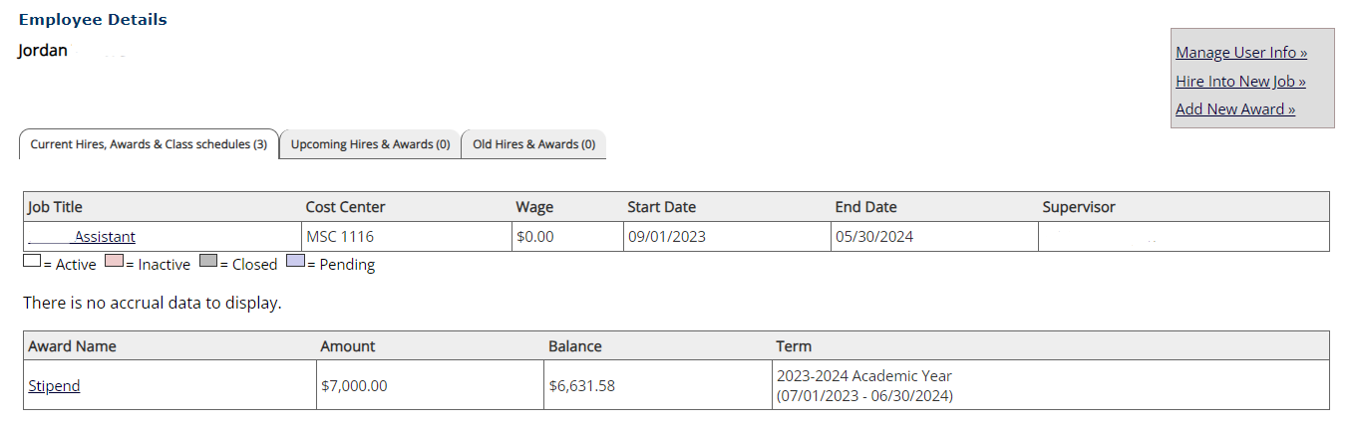
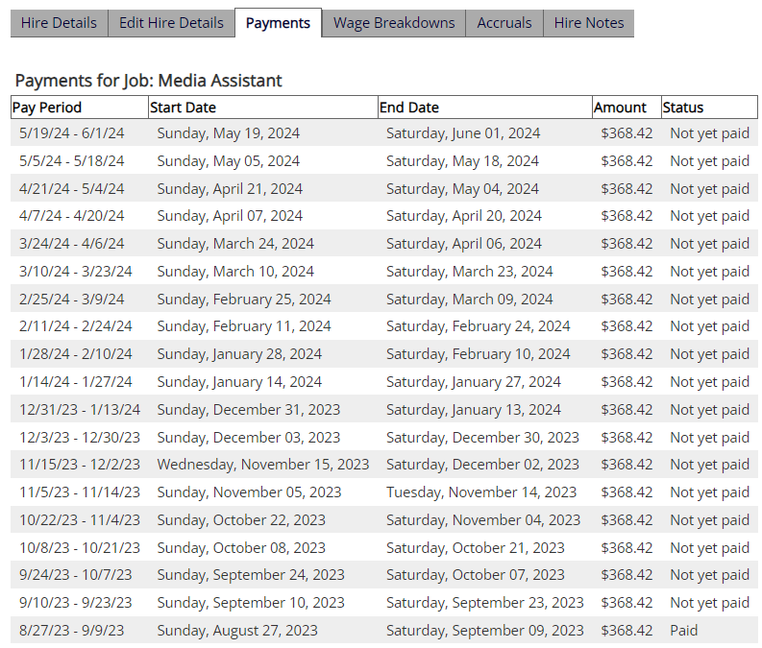
Example of a Stipend Job:
$7000 stipend position that runs from 9/1/23-5/30/24.
The supervisor can see the stipend amount they listed on the job and the remaining balance to be paid.
The supervisor can also see the payment schedule.
Under Stipend, supervisors do not need to approve timesheets, they are automatically set by the parameters of the job posting.

Slide 35
How to Hire an Applicant in NextGen
for
FWS and Campus Employment Jobs

Slide 36
Click on Job Management Login
Click JobX, search for your jobs (enter your name and click Search) and you will get a listing of your jobs
Please

Slide 37
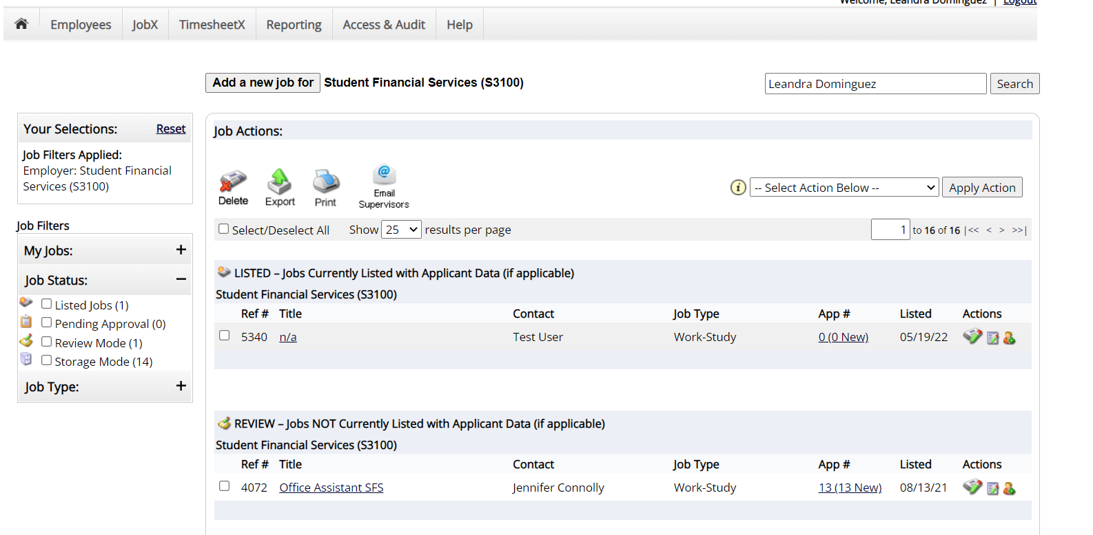
Search for your jobs (enter your name and click Search) and you will get a listing of your jobs.
Select applications under App# to view the applicants for your job.

Slide 38
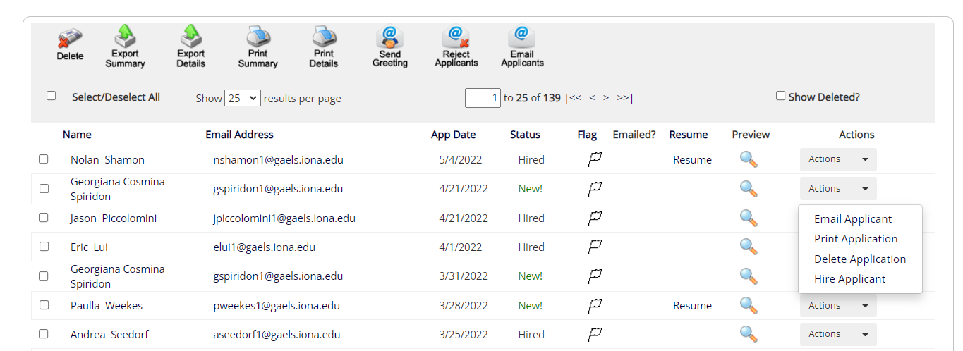
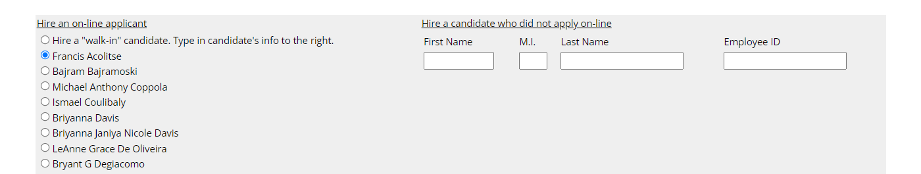
Review your applicants. Click on Action drop down to select Hire Applicant.
Student will be pre-selected for you on the next page.

Slide 39
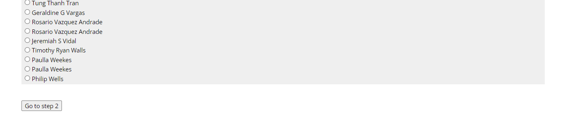
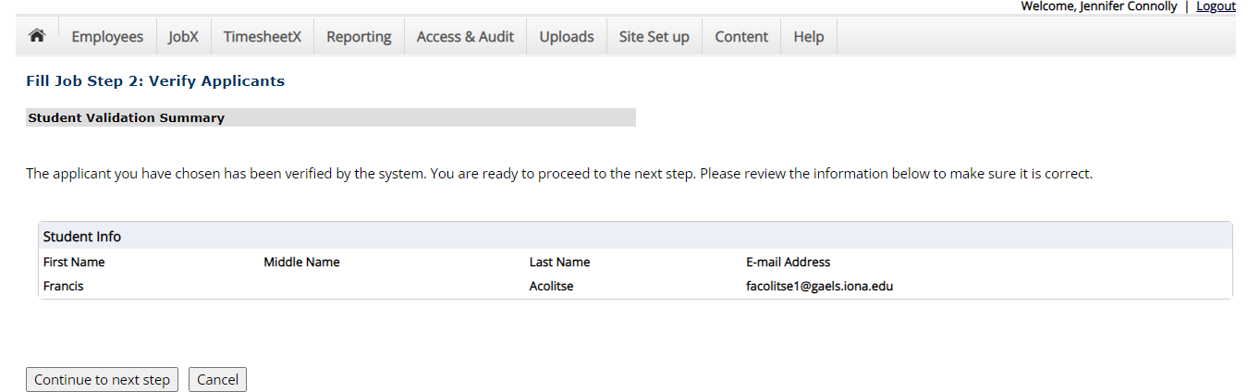
Scroll to the bottom and proceed to Step 2.
Verify student information, Continue to Next Step.

Slide 40
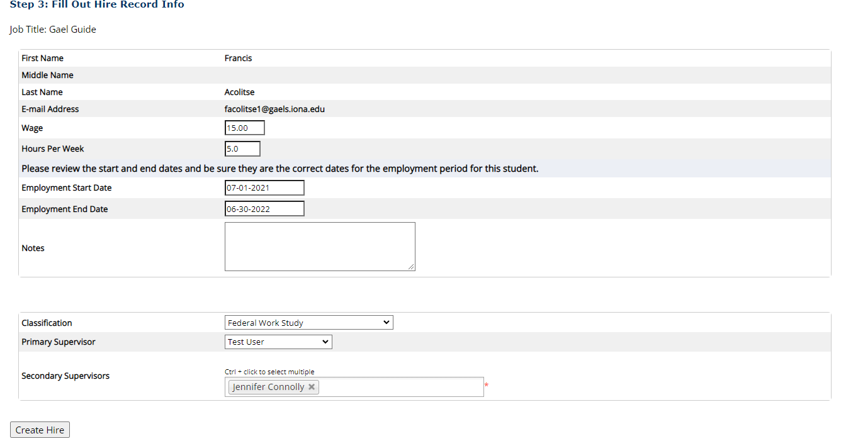
Complete required fields Classification, Primary, Secondary Supervisors. Other fields should be prefilled. Classification must match your job type category.
Click Create Hire.

Slide 41
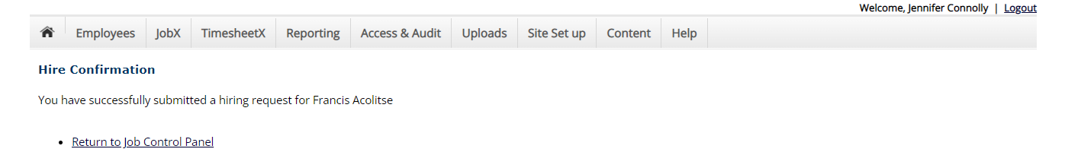
You have now hired the student. Human Resources will contact the applicant to complete On-boarding if required. Please know this is the first step in hiring a student worker. The student must complete On-Boarding if a new hire (On-boarding is not required for re-hires.) A confirmation email from Student Financial Services will be sent to the student and supervisor once the student is officially hired by the University. Only after this confirmation email is received the student is then permitted to begin work.

Slide 42
How to Approve a Student Timesheet in NextGen
(for FWS and Campus Employment Jobs only)

Slide 43
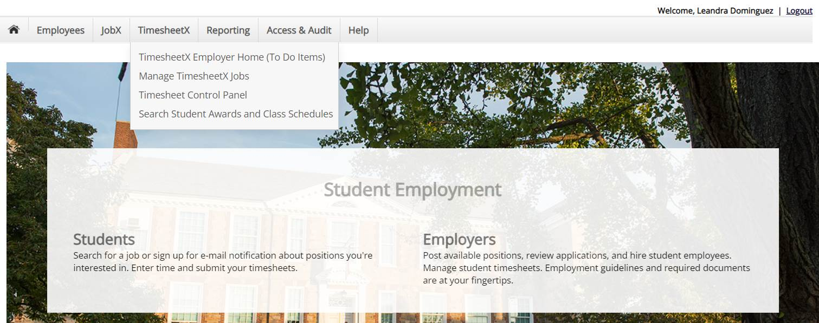
Click on TimesheetX Employer Home (To Do Items)

Slide 44
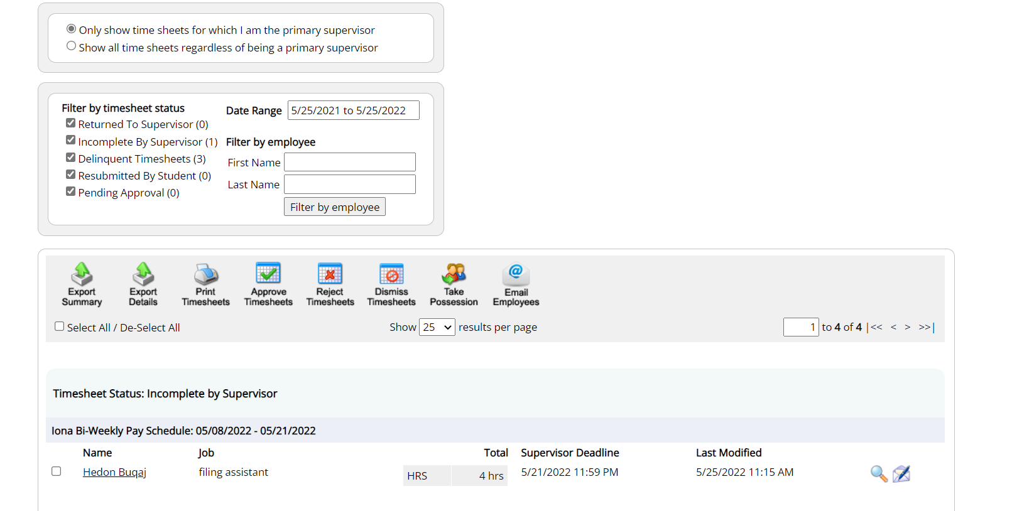
Here you will scroll down to find your student workers, which are in date order from oldest to newest.
Once you find your student, for the current timesheet, click on the student’s name.

Slide 45
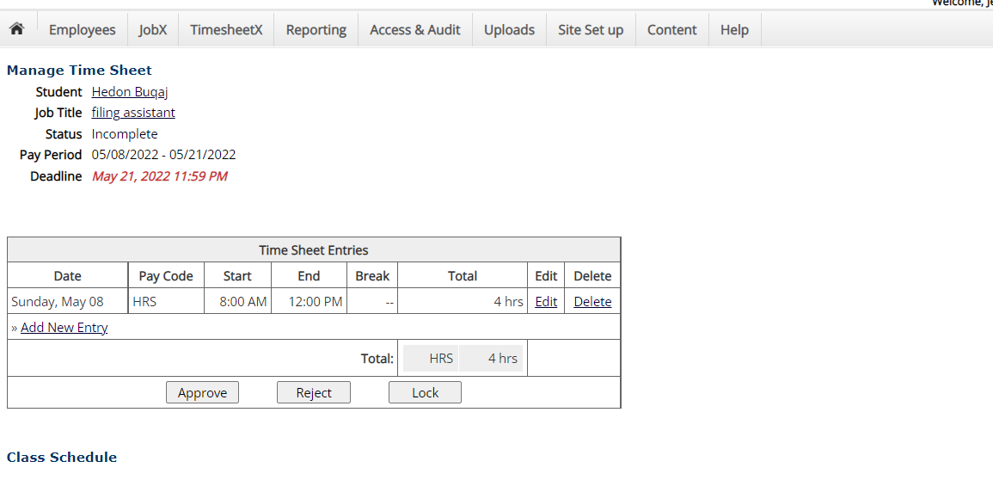
Here you will see their time entries for review. You have the option to edit or delete the entries listed, and you can add a new entry here as well.
Click Approve to approve the student’s timesheet

Slide 46
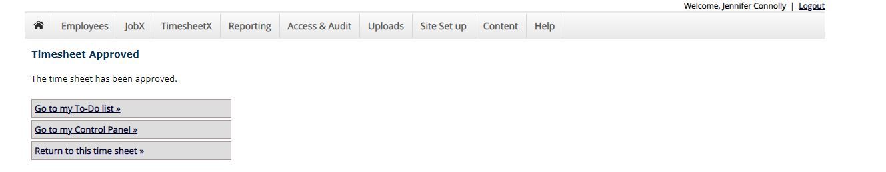
You have approved the student timesheet. To approve additional student timesheets, click Go To My To Do List.

Slide 47
How to Start a Student Timesheet in NextGen

Slide 48
Click on TimesheetX Employer Home (To Do Items)

Slide 49
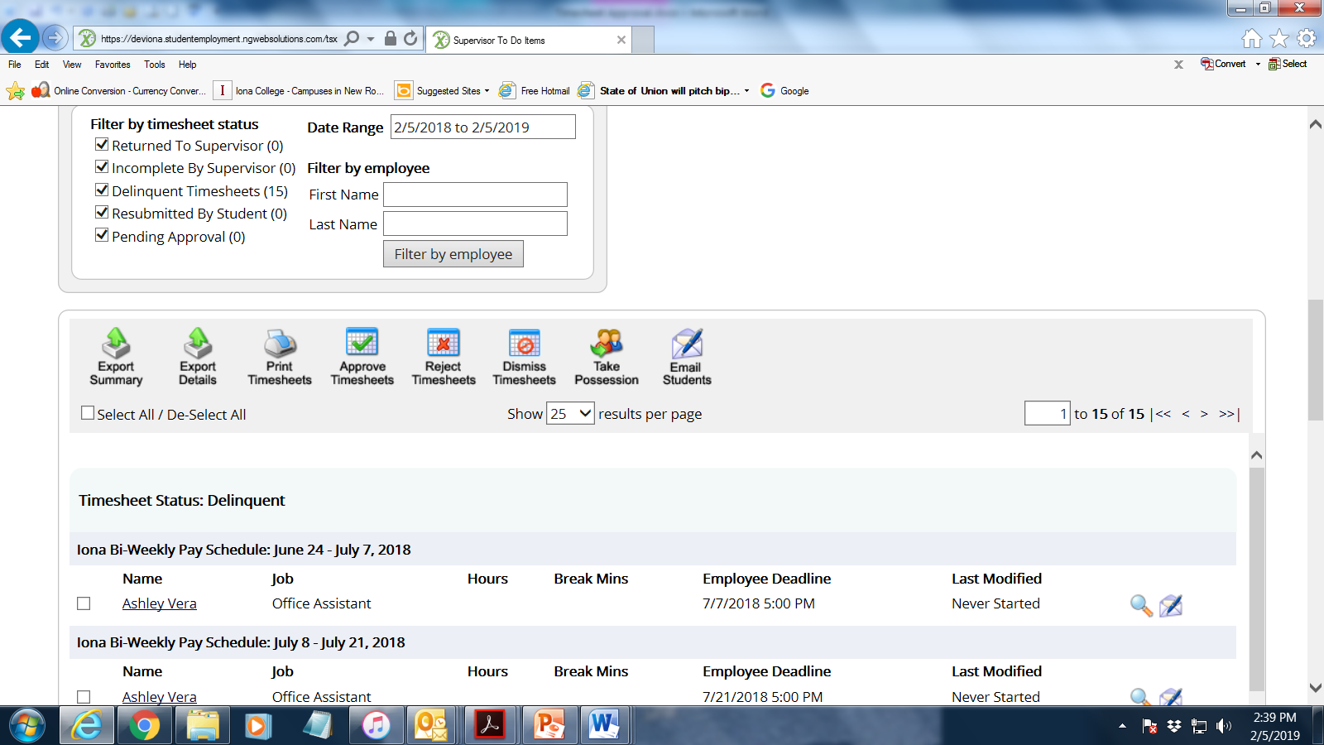
This student never started her timesheet. Click on the student’s name.
Be sure you are selecting the current timesheet; past timesheets cannot be accessed and will not produce a student paycheck.

Slide 50
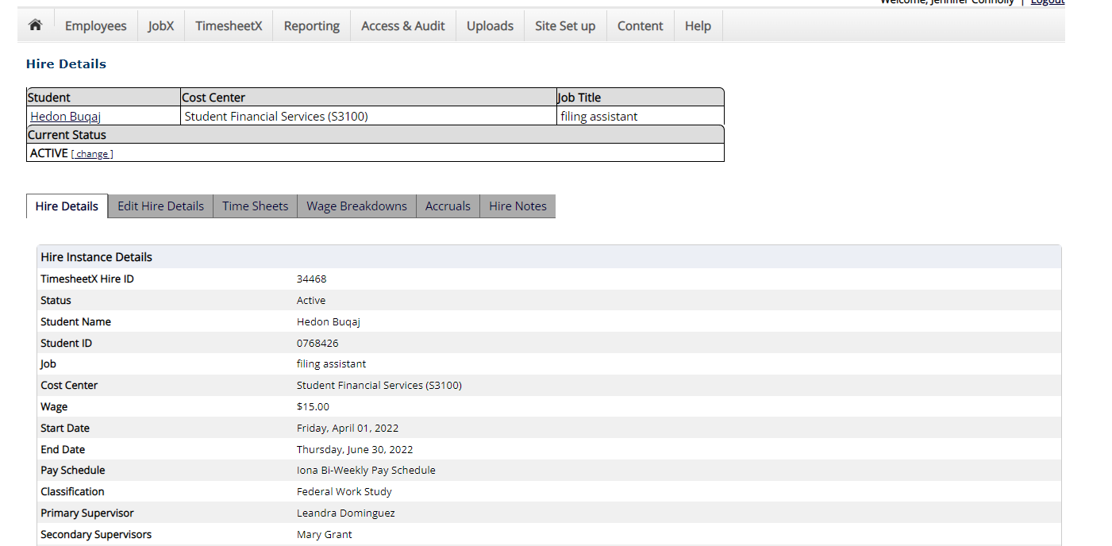
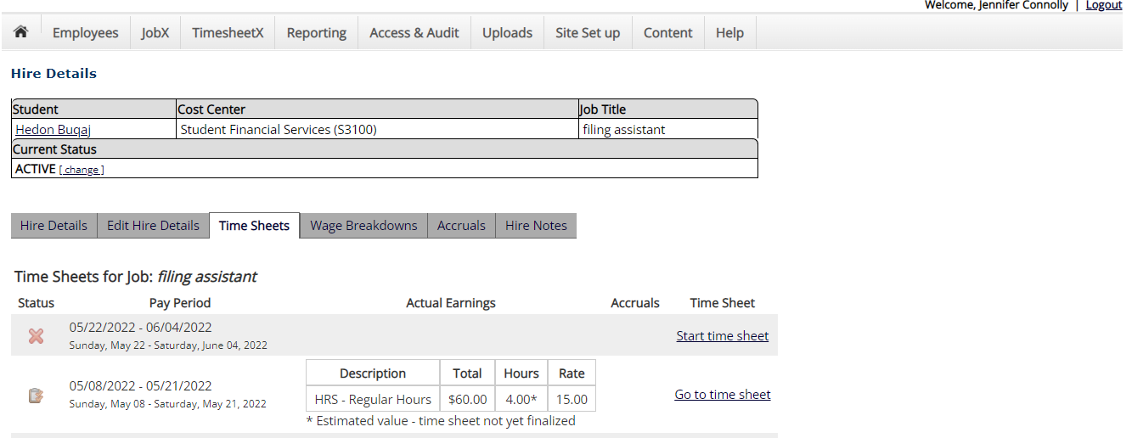
Once in student record, go to Time Sheets.
Click Start Time Sheet

Slide 51
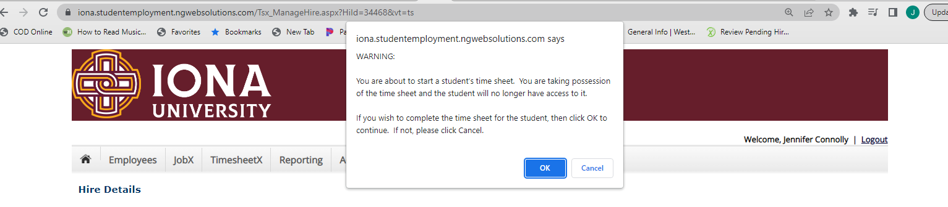
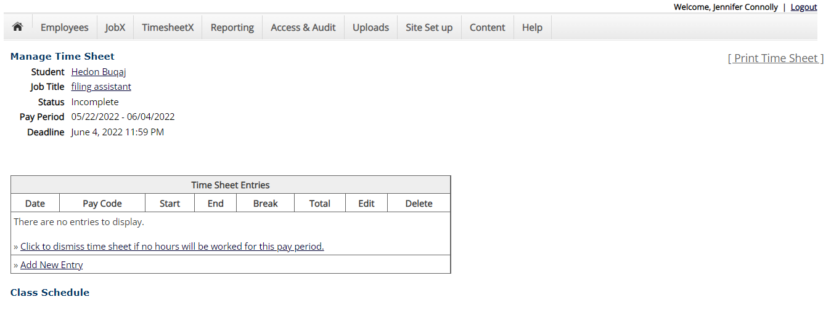
You will get a warning message, click OK to proceed
Once you take possession of a student’s timesheet, they will no longer be able to access it to edit it so it will be your responsibility to enter all hours for that student for that pay period. Be sure to only take possession if the student has not completed the timesheet by the deadline.
Click on Add New Entry to begin

Slide 52
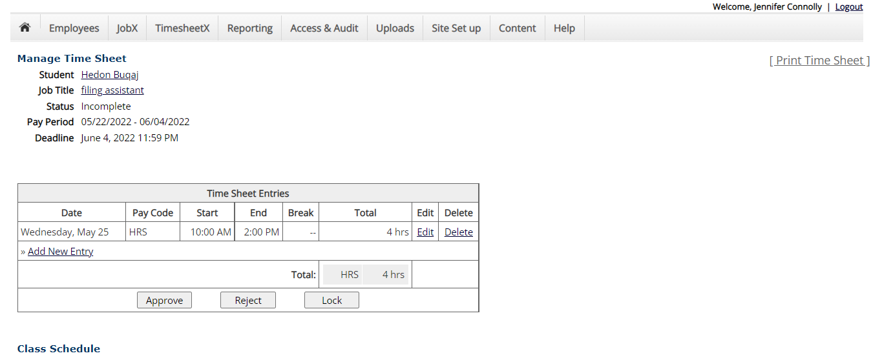
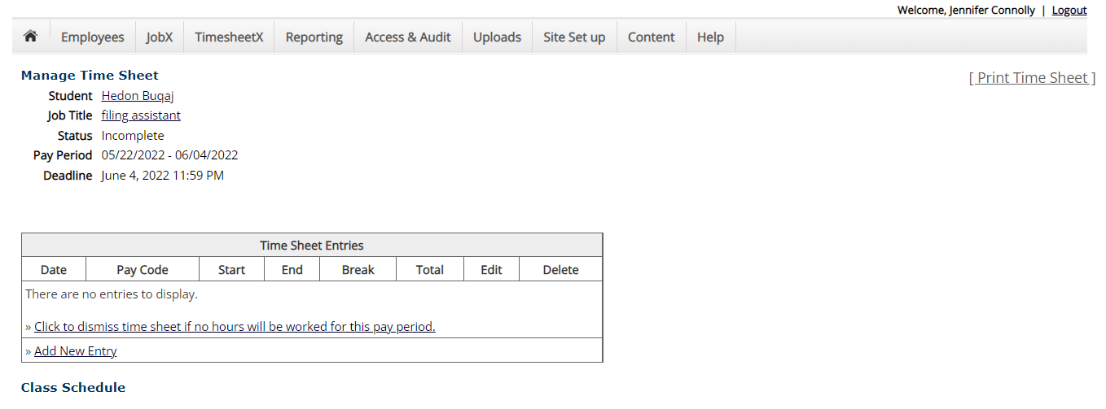
Enter Date, Start & End times, any and breaks taken. Proceed to Add New Entry for all days worked during that pay period. Once completed, Click Approve.
You can also Dismiss a student timesheet here for students if they have no hours to enter for that pay period.

Slide 53
How To Remove a Job From Storage in NextGen

Slide 54
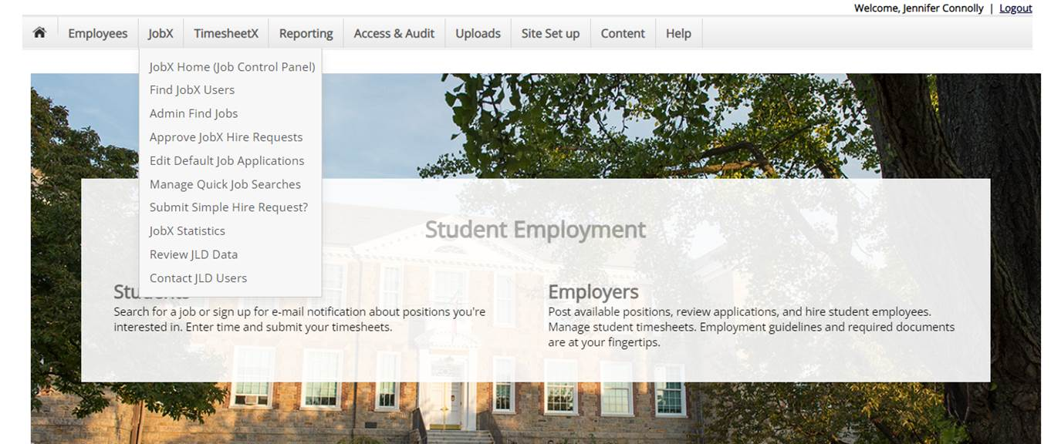
Click on JobX Home (Job Control Panel)

Slide 55
Search your name to find your jobs

Slide 56
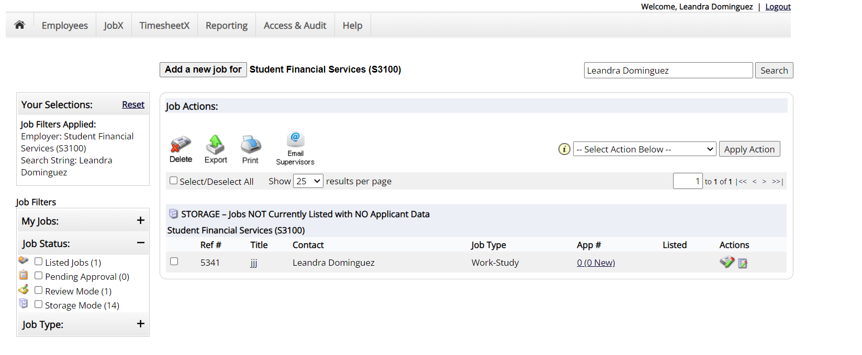
Click on selected jobs in Storage you wish to repost

Slide 57
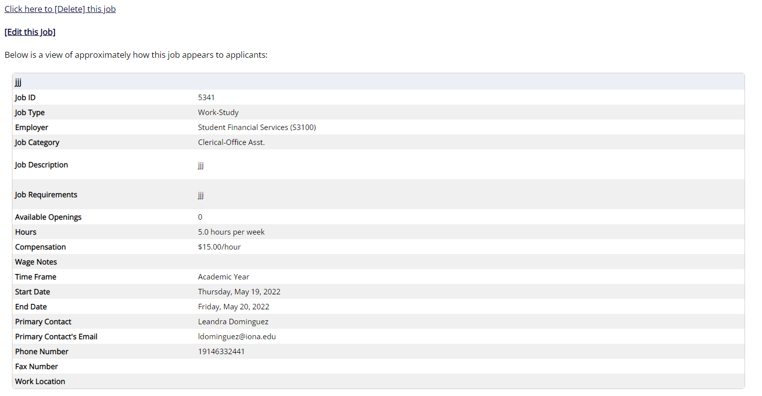
Click Edit this Job

Slide 58
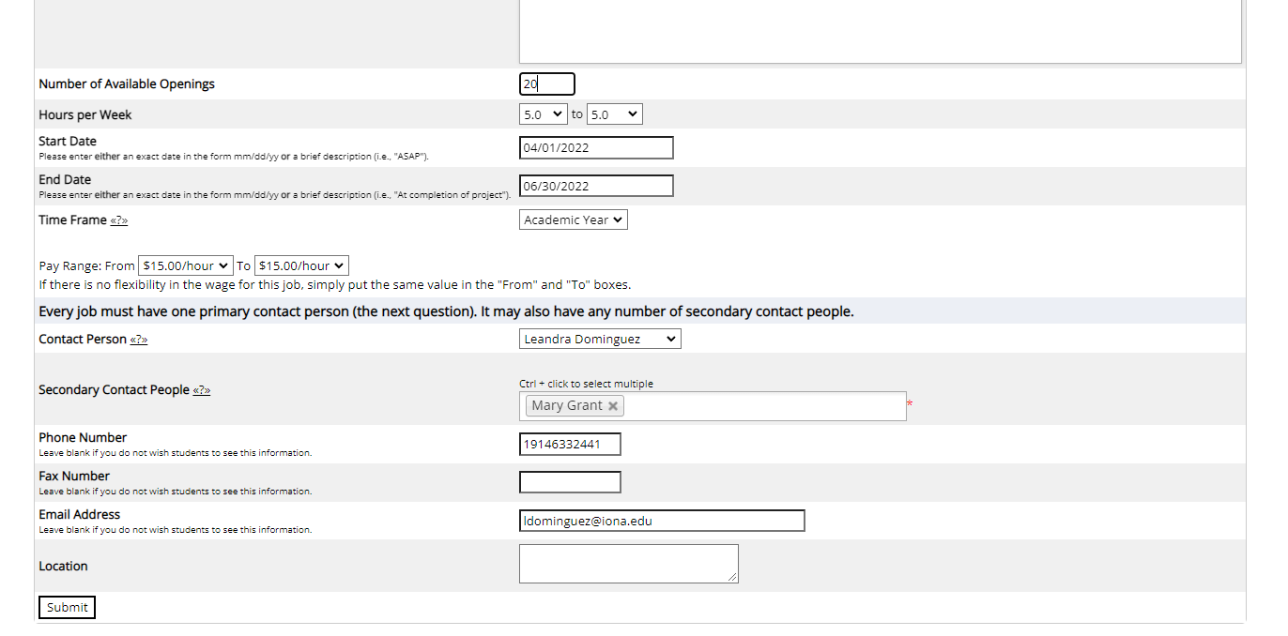
**All jobs in Storage have 0 Openings, you MUST edit the job to list a # of Openings above 0 or the job will never list**
Edit the # of Openings, description, wage, supervisors, etc., anything that has changed since the job was previously listed. Start and End date must not cross fiscal years. (7/1/****-6/30/****)
Be sure to select a Secondary Supervisor
Click Submit

Slide 59
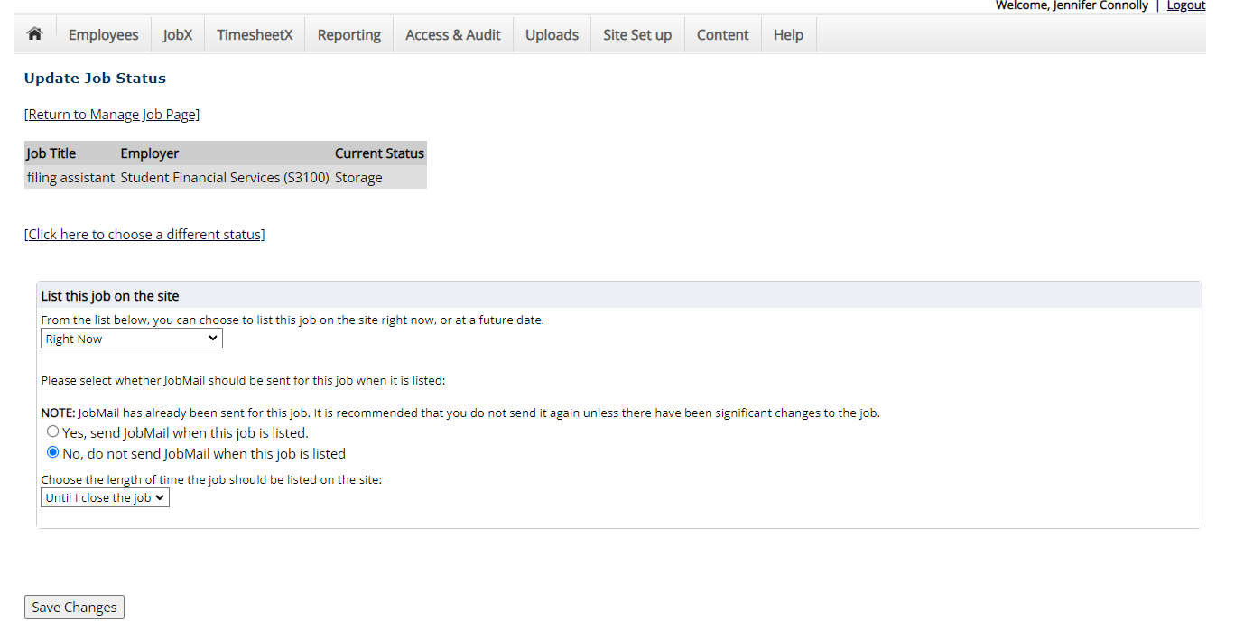
Review your listing start date and for how long you want it available on the site for application.
Click Save Changes.

Slide 60
Your job has been sent over for Administrative review/approval. Once reviewed, you will receive an email confirming it’s posting to the site or a rejection if corrections need to be made.

Slide 61
Questions regarding NextGen
Questions regarding Paycom
Jennifer Connolly, Student Financial Services
jconnolly@iona.edu
  NextGen Access
  Job Postings
  Timesheets
  Federal Work Study
Lucia Bleidner, HR
lbleidner@iona.edu
  On Boarding
  Direct Deposit
  Taxes
  Pay stubs
  W2’s

